Slide 1


FraudShield
Presented By:
Bijay Koirala
Kaushal Joshi

Slide 2




Introduction
A web-based fraud detection tool for online transactions
Checks transactions against known fraud patterns
Uses rule-based scoring (not AI/ML)
Provides a dashboard for monitoring
Includes bulk file processing

Slide 3

Problem Statement
Why we built this:
Small businesses need fraud protection too
Existing solutions are expensive
Many tools are overly complex
No transparent scoring systems

Slide 4




Objectives
To implement a fraud detection system that provides risk scores based on predefined security rules and delivers transaction decisions within acceptable response time

Slide 5

Scopes And Limitations
Scopes
Limitation
Rule-based fraud detection for online transactions
Web dashboard with API access
Bulk CSV/Excel file processing
No machine learning capabilities
Cannot detect new fraud patterns
Manual rule updates required

Slide 6
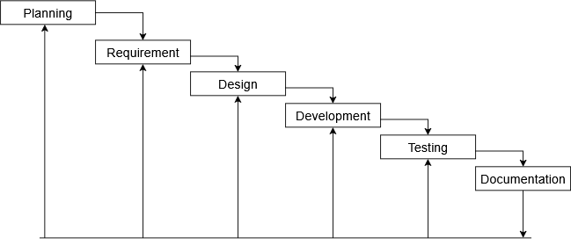
Development Methodology
Fig: Iterative Waterfall Methodology For FraudShield System

Slide 7
Requirement analysis
Functional Requirements
Non-Functional Requirements
Accept transaction data (email, IP, card, amount)
Calculate fraud score using rules
Achieve fraud detection accuracy above 50%
Performance: Process bulk file within 5 seconds
Reliability: Handle invalid data without crashing
Usability: Self-explanatory interface without manual

Slide 8
Feasibility Study
Technical Feasibility
Operational Feasibility
Economic Feasibility
Existing technologies (Flask, MongoDB, JavaScript)
No advanced algorithms required
Libraries available for all features
Simple enough for small businesses
Clear documentation provided
No special training required
All tools used are free/open source
No specialized hardware needed

Slide 9

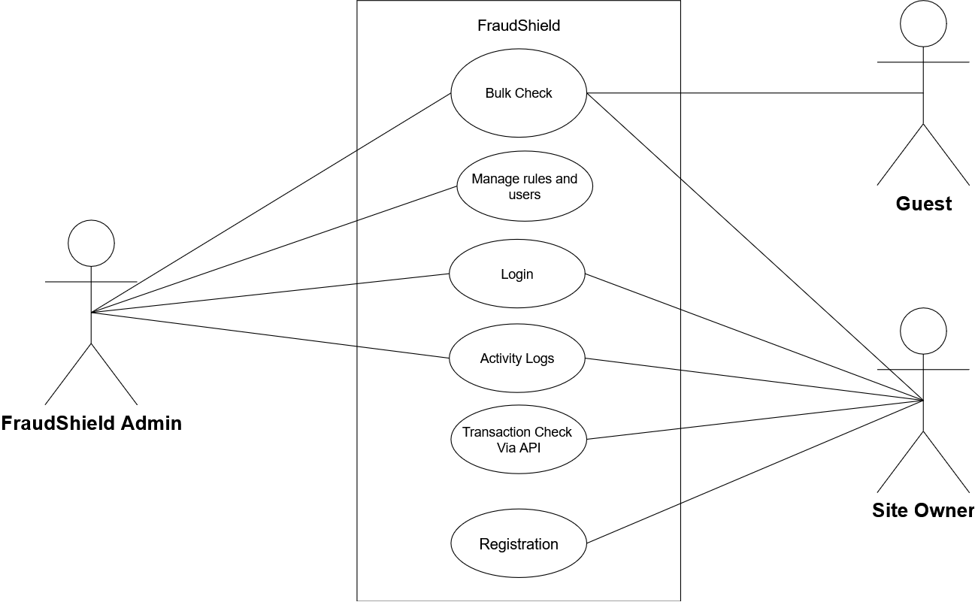
Use Case
Diagram

Slide 10
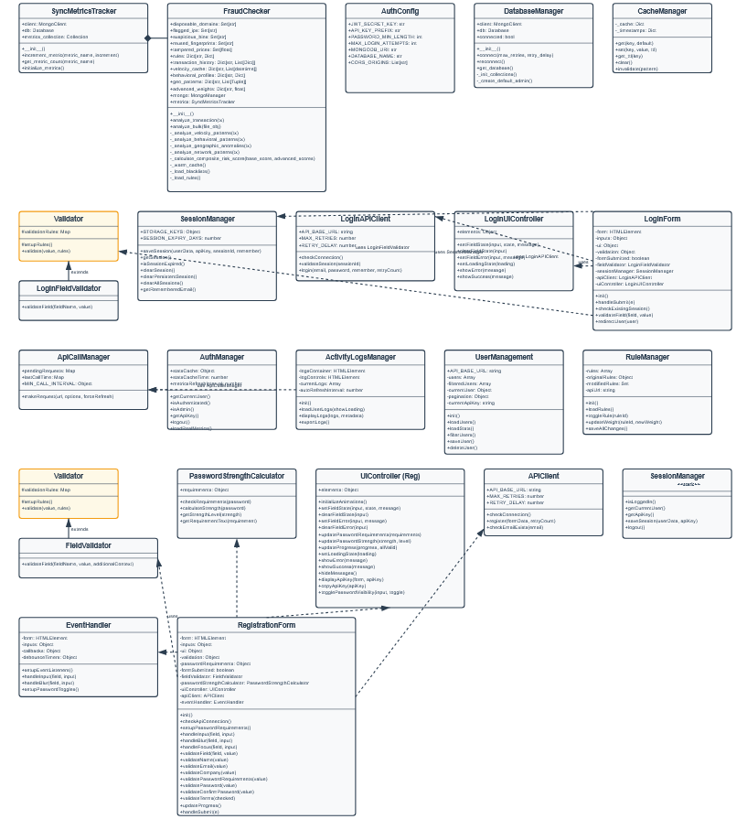
Class Diagram

Slide 11
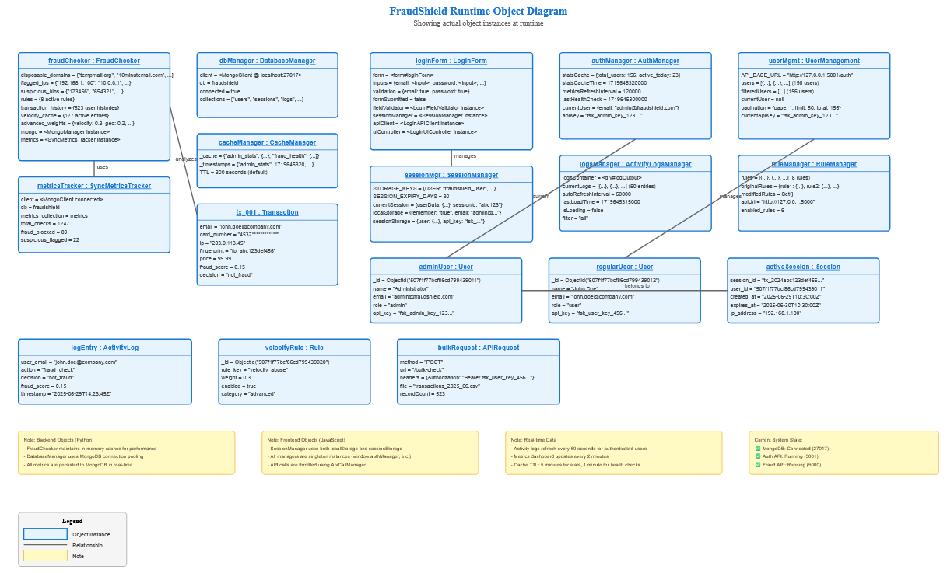
Object Diagram

Slide 12
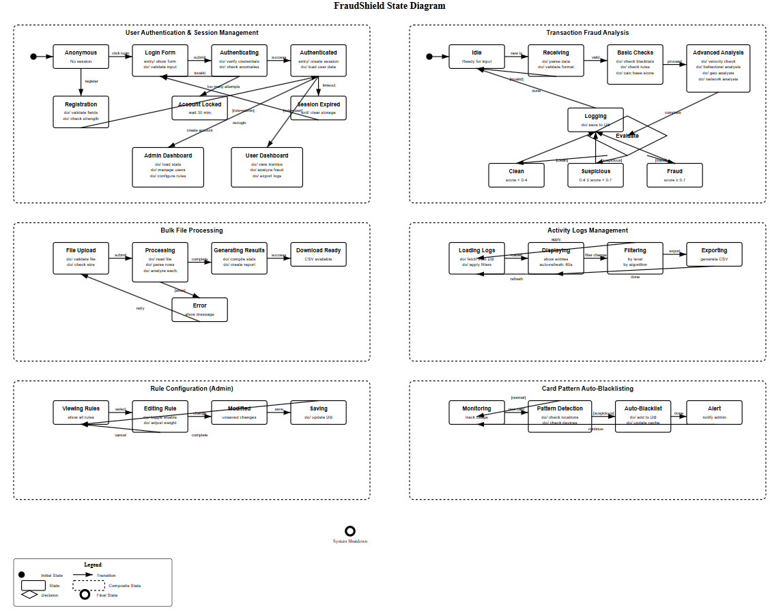
State Diagram

Slide 13
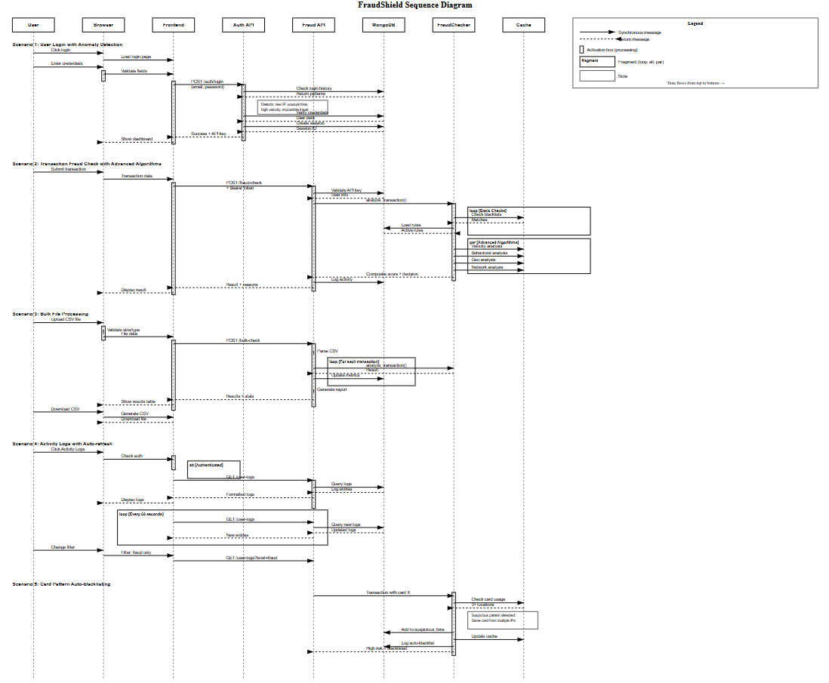
Sequence Diagram

Slide 14
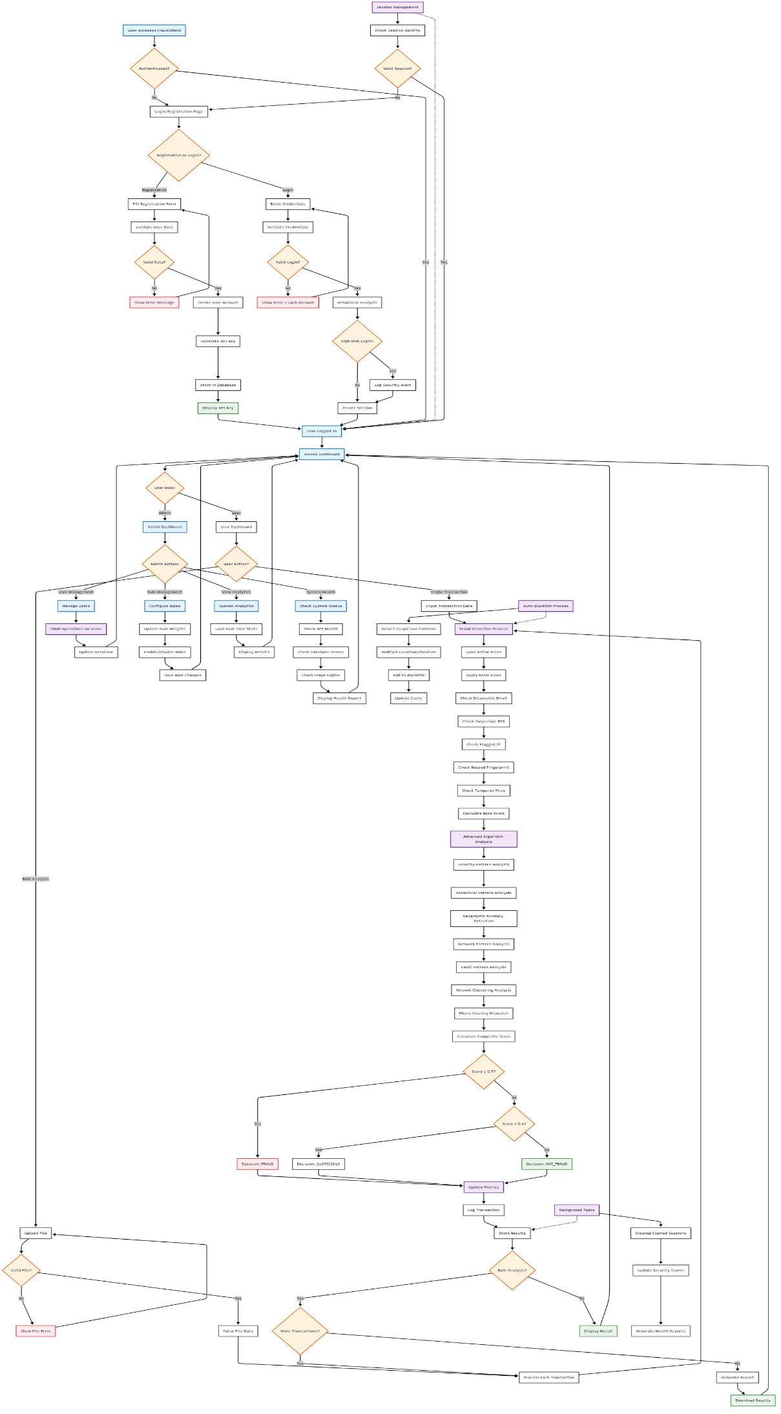
Activity Diagram

Slide 15
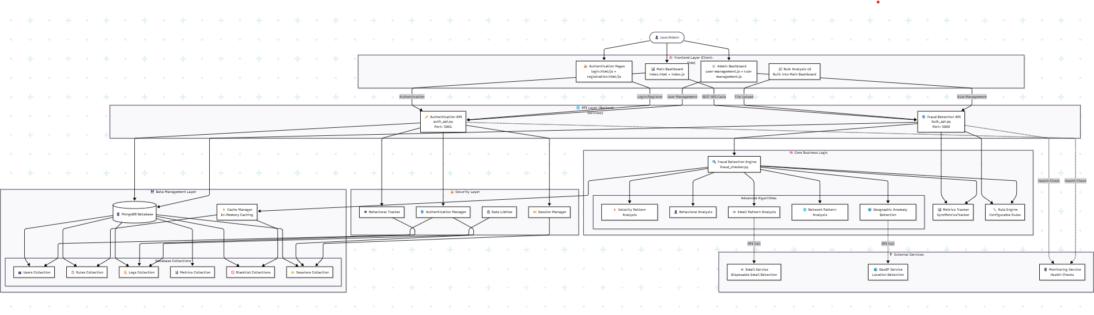
Component Diagram

Slide 16
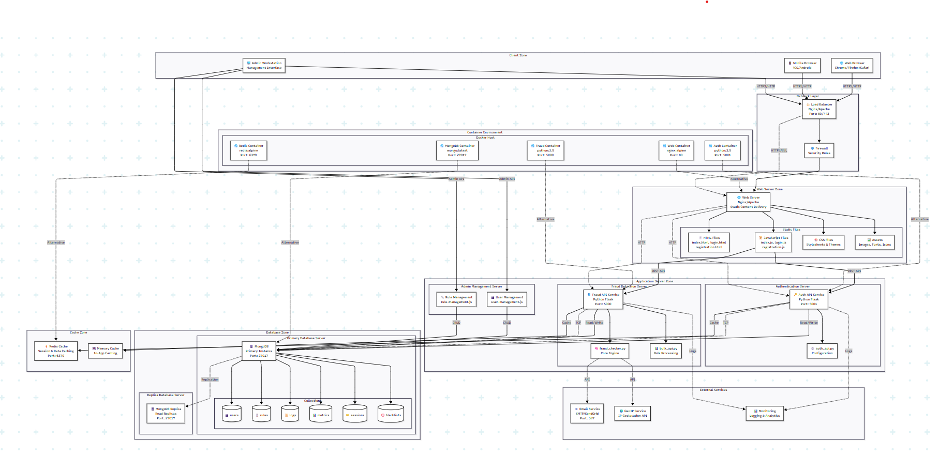
Deployment Diagram

Slide 17
Algorithm Used
Velocity Pattern Detection Algorithm
Behavioral Deviation Algorithm
Composite Score Calculation
YARA
Catches fraudsters trying many transactions fast
Counts how many times same email buys
Too many in 1 minute = Bad
Blocks card/bin attacks
Finds weird purchase amounts
Looks at what user normally spends
Current purchase way too high/low = Suspicious
Uses basic math (average + variation)
Catches stolen card big purchases
Adds everything up
Each red flag has points
Add all points together
High score = Fraud
Medium score = Check manually
Low score = Let it through

Slide 18
Conclusion
The system can detect common fraud patterns and process
bulk transaction files, meeting our project objectives.
Future improvements could include machine learning integration and real-time pattern updates.

Slide 19


THANK YOU

